Slide 1

Ancient Greece: A Glimpse Into a Pioneering Civilization
Exploring the foundations of Western civilization
Notes:
AI-generated content may be incorrect. --- Ancient Greece is often regarded as the cradle of Western civilization. This presentation will explore its geography, society, political systems, cultural contributions, scientific advancements, and military history, shedding light on how this remarkable civilization shaped the world.

Slide 2
Agenda of Topics
Geography and City-States
Greek Society and Culture
Political Systems and Governance
Contributions to Arts and Literature
Science, Technology, and Innovations
Military Conflicts and Expansion
Notes:
We will begin with an overview of the geographical landscape of Ancient Greece and the rise of its city-states. Next, we will delve into the social structure and cultural practices of the Greeks. We’ll then examine their political systems, arts, and literature, followed by their innovations in science and technology. Finally, we will explore the military conflicts that defined this civilization.

Slide 3
Geography and City-States
Notes:
The unique geographical features of Ancient Greece significantly influenced its development. The mountainous terrain and proximity to the sea led to the emergence of independent city-states known as 'polis'.

Slide 4
Geographical Landscape of Ancient Greece
Mountainous Mainland
The mountainous terrain of Ancient Greece contributed to the development of independent city-states, each unique in culture and governance.
Islands of Greece
A series of islands characterized Ancient Greece, fostering distinct communities and facilitating maritime trade.
Trade and Cultural Exchange
The Aegean Sea played a crucial role in trade and cultural exchange between the city-states of Ancient Greece.
Notes:
Ancient Greece consisted of a series of islands and a mountainous mainland. This geography led to the creation of individual city-states, each with its own government and culture. The sea also facilitated trade and cultural exchange.

Slide 5

The Rise of City-States (Polis)
Emergence of City-States
City-states, known as 'polis', began to emerge in the 8th to 6th centuries BCE, marking a significant political development.
Independent Functioning
Each city-state operated independently, establishing its own military, government, and legal systems, leading to unique identities.
Cooperation and Conflict
The independence of city-states resulted in both cooperation for mutual benefit and conflicts over resources and power.
Notes:
City-states, or 'polis', emerged between the 8th and 6th centuries BCE. Each city-state functioned independently, with its own military, government, and laws, leading to both cooperation and conflict among them.

Slide 6
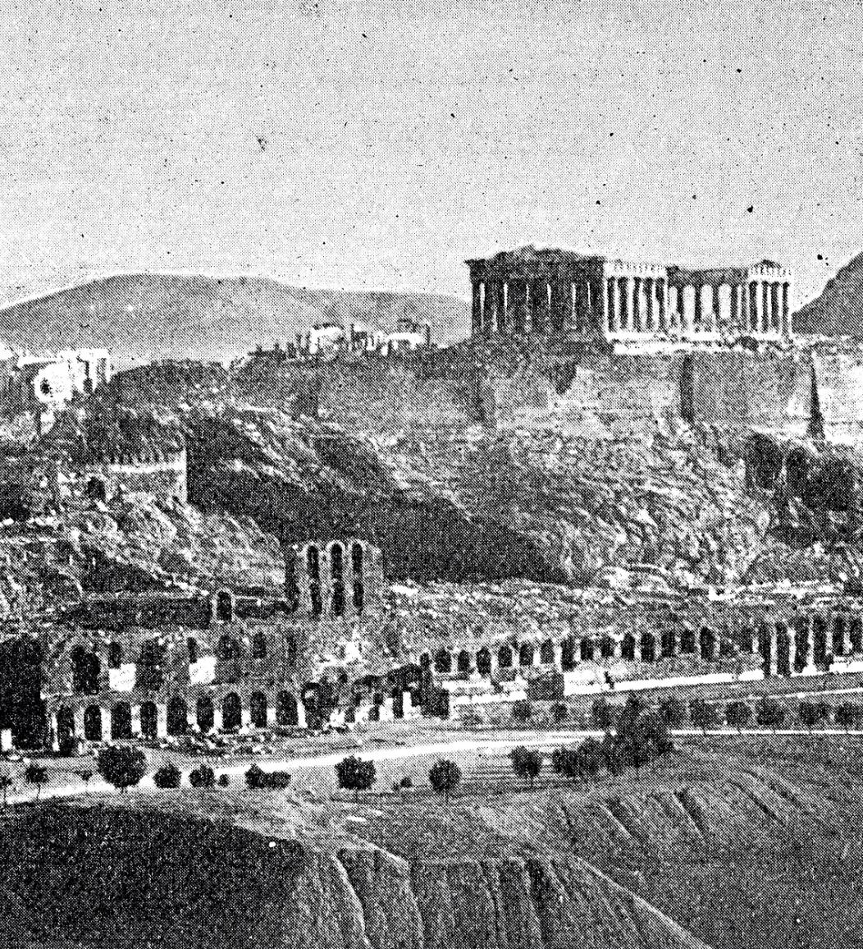
Key City-States: Athens, Sparta, Corinth
Athens and Democracy
Athens is celebrated for its democratic governance, making significant contributions to culture, philosophy, and arts.
Spartan Militarism
Sparta was known for its disciplined society and military prowess, focusing on warfare and training elite soldiers.
Corinthian Trade Center
Corinth thrived as a major trade center, renowned for its wealth, innovation, and economic significance in ancient Greece.
Notes:
Athens, known for its democratic governance and cultural achievements, contrasted with Sparta, a militaristic society focused on discipline and warfare. Corinth was a major trade center renowned for its wealth and innovation.

Slide 7
Greek Society and Culture
Notes:
Ancient Greek society was complex and varied, with a distinct social hierarchy. The culture was rich in traditions, including religious practices and artistic expression.

Slide 8
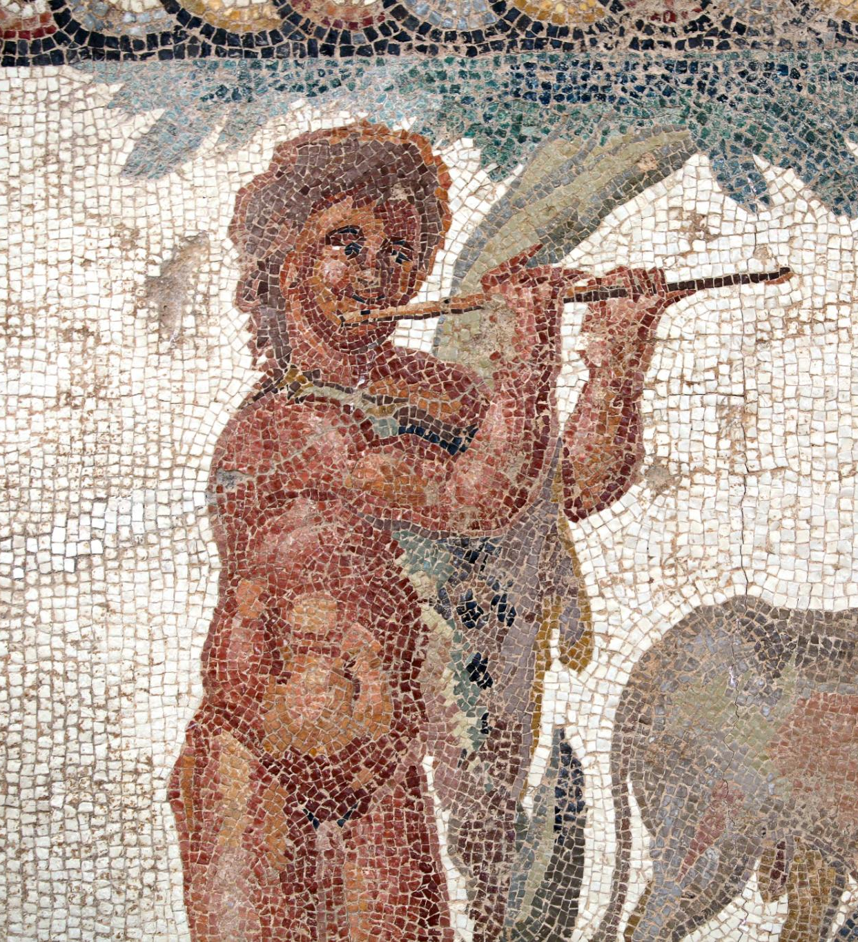
Social Structure and Daily Life
Divisions of Greek Society
Greek society was divided into free citizens, metics, and slaves, each with distinct rights and roles.
Role of Free Citizens
Free citizens engaged in civic duties and were actively involved in cultural and political life, shaping society.
Life of Metics and Slaves
Metics and slaves had limited rights and their daily lives were significantly different from free citizens.
Notes:
Greek society was divided into free citizens, metics (foreigners), and slaves. Daily life varied significantly based on social class, with citizens participating in civic duties and cultural activities.

Slide 9

Role of Men, Women, and Children
Men in Public Life
Men were primarily engaged in politics and public affairs, shaping laws and governance.
Women in Household
Women managed household responsibilities, ensuring the family's well-being and maintaining the home.
Children's Roles in Society
Children were raised to fulfill specific societal roles, with educational paths shaped by gender and class.
Notes:
Men primarily engaged in politics and public life, while women managed the household. Children were raised to fulfill specific roles in society, with education differing based on gender and class.

Slide 10

Religious Beliefs and Mythology
Pantheon of Gods
The Greeks worshipped a rich pantheon of gods and goddesses, each representing different aspects of life and nature.
Mythology and Natural Phenomena
Greek myths were used to explain natural phenomena and human experiences, deepening the connection between religion and daily life.
Cultural Traditions
The mythology and religious beliefs of the Greeks fostered a deep cultural tradition that influenced art, literature, and community practices.
Notes:
Religion played a central role in Greek life. The Greeks worshipped a pantheon of gods and goddesses, whose myths explained natural phenomena and human experiences, fostering a deep cultural tradition.

Slide 11
Political Systems and Governance
Notes:
Ancient Greece was a pioneer of various political systems, most notably democracy and oligarchy, showcasing a range of governance models across its city-states.

Slide 12

Democracy in Athens
Birthplace of Democracy
Athens is widely recognized as the birthplace of democracy, influencing governance worldwide.
Citizen Participation
In Athens, citizens were directly involved in decision-making, a revolutionary concept for governance.
Key Institutions
Institutions like the Assembly and Council played crucial roles in shaping the governance of Athens.
Notes:
Athens is celebrated as the birthplace of democracy. Citizens participated directly in decision-making, with institutions like the Assembly and Council shaping governance.

Slide 13
Oligarchy in Sparta
Characteristics of Oligarchy
Sparta's political system was defined by a small group of elites controlling power and decision-making processes.
Dual Kingship
The dual kingship system in Sparta allowed for a balance of power, with two kings ruling simultaneously.
Council of Elders
The Council of Elders in Sparta, known as the Gerousia, played a crucial role in legislative and judicial matters.
Notes:
Sparta's political system was characterized by oligarchy, where power was held by a small group of elites. The dual kingship and the Council of Elders played significant roles in governance.

Slide 14
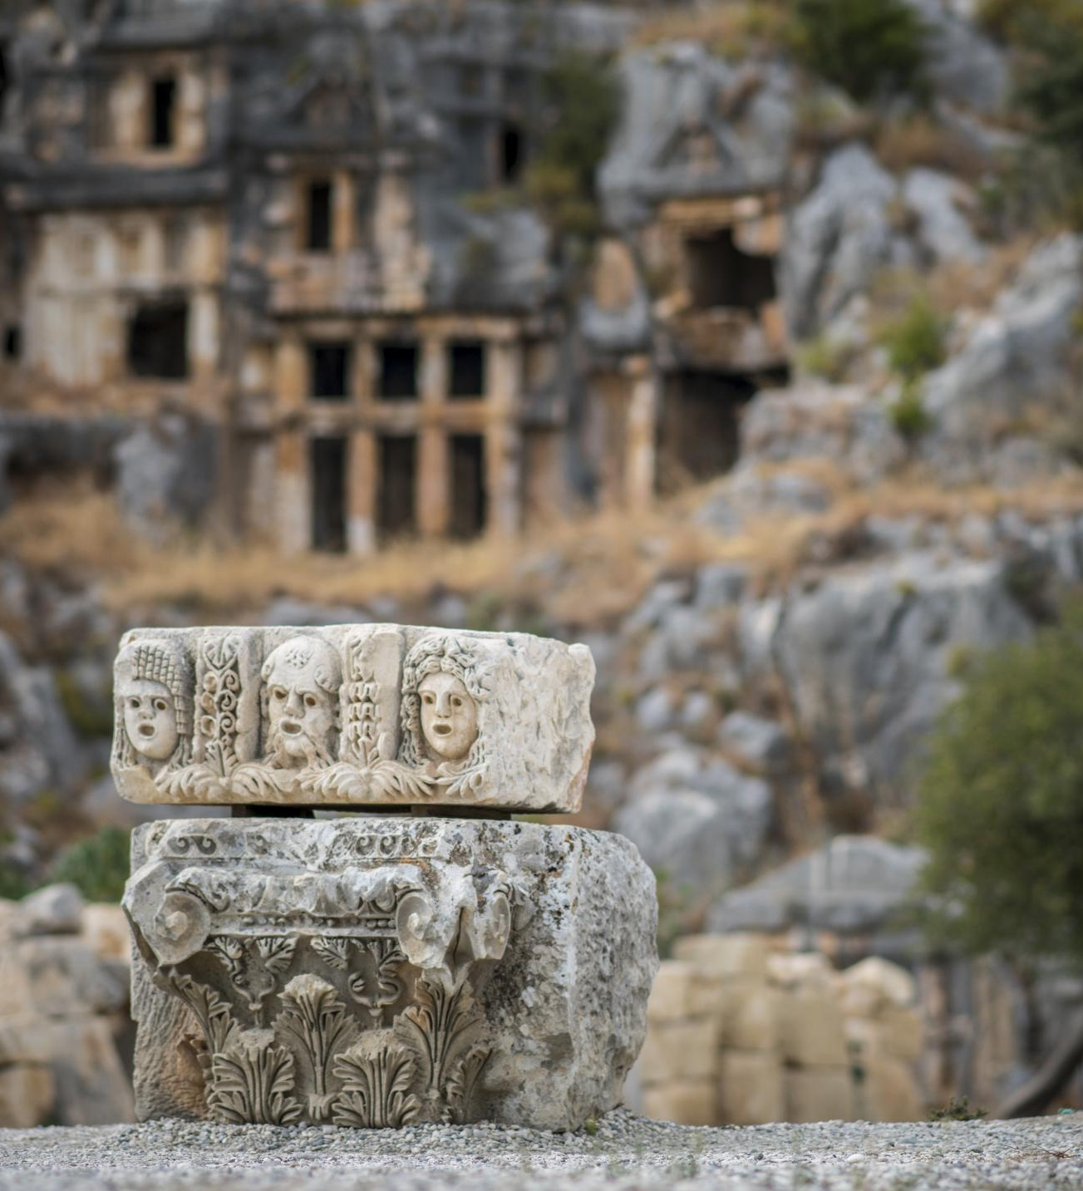
Other Forms of Governance in Different City-States
Corinth's Governance
Corinth adopted a form of governance that reflected its unique local traditions, including elements of tyranny.
Thebes' Political Structure
Thebes embraced an aristocracy, showcasing the influence of its elite class on governance.
Forms of Governance
Different city-states adopted various governance forms, illustrating diverse political landscapes in ancient Greece.
Notes:
Other city-states, such as Corinth and Thebes, adopted various forms of governance, including tyrannies and aristocracies, each reflecting unique local traditions and circumstances.

Slide 15
Contributions to Arts and Literature
Notes:
The cultural achievements of Ancient Greece in arts and literature have left a profound legacy. Their architectural innovations, theatrical works, and philosophical ideas continue to influence contemporary society.

Slide 16

Greek Architecture and Sculpture
Architectural Excellence
Greek architecture is celebrated for its stunning columns and symmetry, particularly evident in iconic structures like the Parthenon.
Sculptural Realism
Sculptures from ancient Greece emphasized realism, capturing human emotion and expressions with incredible detail.
Notes:
Greek architecture is renowned for its columns and symmetry, exemplified by structures like the Parthenon. Sculpture from this era emphasized realism and human emotion.

Slide 17
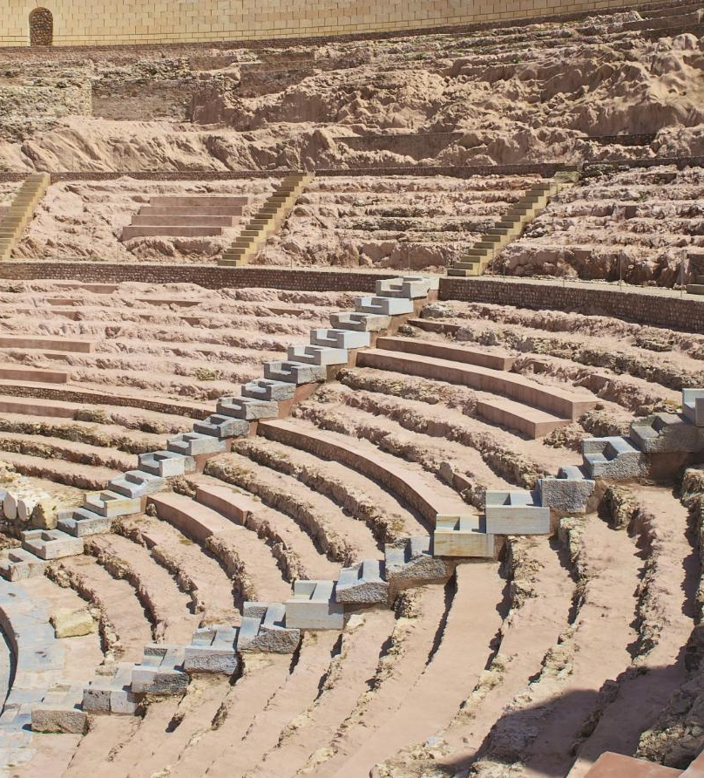
Theatre and Drama: Tragedy and Comedy
Origins of Theatre
The Greeks were the pioneers of theatrical arts, introducing the concepts of tragedy and comedy to audiences.
Prominent Playwrights
Playwrights like Aeschylus, Sophocles, and Aristophanes laid the groundwork for modern drama with their iconic works.
Tragedy and Comedy
Tragedies and comedies were integral to Greek culture, performed in grand amphitheaters to entertain and provoke thought.
Notes:
The Greeks pioneered the theatrical arts, with tragedies and comedies performed in grand amphitheaters. Playwrights like Aeschylus, Sophocles, and Aristophanes are foundational figures in drama.

Slide 18

Philosophy and Notable Philosophers
The Birth of Philosophy
Ancient Greece is considered the birthplace of philosophy, where thinkers began to question existence and the nature of reality.
Socrates and Ethics
Socrates is known for his contributions to ethics and the Socratic method, emphasizing dialogue to explore moral questions.
Plato's Ideals
Plato, a student of Socrates, explored ideas of justice, beauty, and equality, influencing countless philosophical discussions.
Aristotle's Contributions
Aristotle, a student of Plato, made significant contributions across various fields, including logic, metaphysics, and ethics.
Notes:
Philosophy flourished in Ancient Greece, with thinkers like Socrates, Plato, and Aristotle exploring fundamental questions about existence, ethics, and governance, laying the groundwork for Western philosophy.

Slide 19
Science, Technology, and Innovations
Notes:
The Ancient Greeks made significant strides in various fields of science and technology, influencing future generations with their discoveries and inventions.

Slide 20
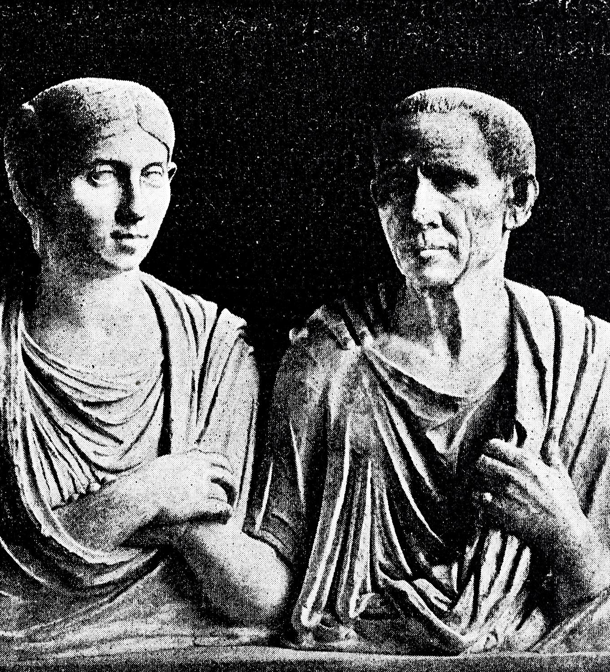
Advancements in Mathematics and Astronomy
Contributions to Geometry
Greek mathematicians such as Euclid and Pythagoras made significant advancements in geometry, shaping mathematical concepts that are still used today.
Heliocentric Theories
Astronomers like Aristarchus proposed heliocentric models of the solar system, challenging the geocentric views long before Copernicus.
Notes:
Greek mathematicians like Euclid and Pythagoras made groundbreaking contributions to geometry and mathematics. Additionally, astronomers like Aristarchus proposed heliocentric theories long before Copernicus.

Slide 21

Inventions and Engineering Feats
Antikythera Mechanism
The Antikythera mechanism is considered the world's first analog computer, showcasing the ingenuity of ancient Greek engineering.
Advanced Construction Techniques
Ancient Greeks developed advanced construction techniques, evident in their enduring structures like temples and theaters.
Hydraulic Engineering
Greek engineers advanced hydraulic techniques, improving water management systems for cities and agriculture.
Notes:
Ancient Greeks were innovative engineers, creating inventions like the Antikythera mechanism, an ancient analog computer, and developing advanced techniques in construction and hydraulics.

Slide 22

Medicine and Scientific Inquiry
Hippocratic Principles
Hippocrates emphasized the importance of observation and ethics in the practice of medicine, establishing foundational principles for healthcare.
Legacy in Modern Medicine
The principles laid down by Hippocrates continue to influence medical ethics and practice in modern healthcare systems worldwide.
Notes:
Hippocrates, often regarded as the father of medicine, established principles that emphasized observation and ethics in healthcare. His legacy continues to influence modern medicine.

Slide 23
Military Conflicts and Expansion
Notes:
Military prowess defined Ancient Greece, with conflicts shaping its history and territorial expansion, notably through the Persian Wars and the campaigns of Alexander the Great.

Slide 24

The Persian Wars
Background of the Wars
The Persian Wars were crucial conflicts between the Greek city-states and the expansive Persian Empire.
Battle of Marathon
The Battle of Marathon was a significant turning point, where the Athenians achieved a surprising victory against the Persians.
Battle of Thermopylae
The Battle of Thermopylae showcased heroic resistance by a small Greek force led by King Leonidas against a much larger Persian army.
Notes:
The Persian Wars were a series of conflicts between Greek city-states and the Persian Empire. Key battles like Marathon and Thermopylae showcased Greek unity and valor against a formidable foe.

Slide 25

The Peloponnesian War
Conflict Overview
The Peloponnesian War marked a significant conflict that pitted Athens against Sparta, altering the political landscape of ancient Greece.
Shifts in Power
The outcome of the war led to crucial shifts in power among Greek city-states, affecting their dominance and influence.
Vulnerabilities Revealed
The war exposed the vulnerabilities of the city-states, highlighting weaknesses in their alliances and governance.
Lasting Consequences
The lasting consequences of the Peloponnesian War shifted Greek society, culture, and political structures for years to come.
Notes:
The Peloponnesian War was a protracted conflict between Athens and Sparta, leading to significant shifts in power. The war revealed the vulnerabilities of the city-states and had lasting consequences for Greece.

Slide 26

Conquests of Alexander the Great
Expansion of Greek Influence
Alexander the Great's conquests significantly expanded Greek influence across Europe, Asia, and Africa, shaping the course of history.
Military Strategies
His innovative military strategies and tactics were instrumental in achieving numerous victories against larger armies.
Hellenistic Culture
The conquests of Alexander led to the spread of Hellenistic culture, blending Greek and Eastern influences across conquered regions.
Notes:
Alexander the Great's conquests expanded Greek influence across three continents. His military strategies and vision for a unified empire transformed the ancient world and spread Hellenistic culture.

Slide 27
Conclusion
Cultural Contributions
Ancient Greece made significant cultural contributions that shaped modern art, literature, and theater. These practices continue to influence contemporary society.
Philosophical Legacy
The philosophical ideas developed in Ancient Greece laid the groundwork for Western philosophy, touching various aspects of human thought and ethics.
Government Innovations
Ancient Greece introduced concepts of democracy and civic participation that are foundational to modern political systems around the world.
Scientific Advancements
The scientific methods and discoveries in Ancient Greece laid the groundwork for modern science, influencing fields like mathematics and astronomy.
Notes:
Ancient Greece's rich history, cultural contributions, and innovations laid the foundation for many aspects of modern civilization. Its legacy continues to resonate in areas such as government, philosophy, art, and science.

